Slide 1

SuzukaAgent
Soto Hisakawa
Graduate School of Mathematics, Kyushu University Japan
Notes:
Hello everyone. My name is Soto Hisakawa. I’m Graduate School of Mathematics, Kyushu University Japan. Today, I’d like to talk about My Agent for SCML OneShot Track SuzukaAgent.

Slide 2
Table of Contents
Introduction
Proposal Strategy
Acceptance Strategy
Evaluation
Conclusion
Notes:
My presentation is divided into 5 parts. I’ll start with talking about Introduction, Proposal Strategy, Acceptance Strategy, Evaluation, and Conclusion. Now, let’s begin.

Slide 3
Introduction 1/3
Target
Purse the best unit price while ensuring the fulfillment of quantity requirement
Strategy direction
Propose the best unit price In acceptance, Adjust the degree of compromise on the unit price based on the advantages or disadvantages of the situation
Notes:
Since last year’s tournament, the unit price consists of only two values, with a difference of one between them. As a result, it has become paramount to fulfill the quantity. QuantityOrientedAgent prioritized fulfilling the quantity and emerged victorious in last year’s tournament. In this tournament, I believe that pursuing the best unit price while ensuring the fulfillment of quantity requirements is crucial.
And, The strategy direction of SuzukaAgent is Proposing the best unit price and In acceptance, adjusting the degree of compromise on the unit price based on the advantages or disadvantages of the situation.

Slide 4

Introduction 2/3 ~Disadvantage Situation~
At level 0 (the quantity required for all factories at level 0 is greater than that at level 1)
Towards the end of the day (step > 18)
Doesn't work well with other factory agents
(p, q)
(p_{1,6},q_{1,6})
p: unit price
q: quantity
(p_{0,1},q_{0,1})
(p_{1,7},q_{1,7})
(p_{6,10},q_{6,10})
(p_{0,2},q_{0,2})
(p_{7,10},q_{7,10})
Exogenous Contracts
(p_{0,3},q_{0,3})
・・・
・・・
level 0
level 1
Negotiation
raw material
intermediate product
final product
Notes:
I consider the following three situations as disadvantageous.
First, At level 0 (Because the quantity required for all factories at level 0 is greater than that at level 1)
Second, Towards the end of the day (specifically, step is greater than 18)
Third, Doesn’t work well with other factory agents
In these situations, It is difficult to fulfill quantity requirements.

Slide 5
Introduction 3/3 ~Definitions of Words~
Needs:
The current quantity required
The best unit price:
The highest unit price (level 0)
The lowest unit price (level 1)
The worst unit price:
The lowest unit price (level 0)
The highest unit price (level 1)
Notes:
I’ll talk about difinitions of words.
First Needs means the current quantity required.
Second, the best unit price means in level 0 the highest unit price, otherwise in level 1 the lowest unit price.
Third, The lowest unit price means in level 0 the lowest unit price, otherwise in level 1 the highest unit price.

Slide 6
Proposal Strategy 1/2
Proposal Strategy
The proposal unit price: The best unit price The proposal quantity: needs (the number of parents = 1) ⌈needs/2⌉(else)
We based this decision on the data from reinforcement learning for the best proposal strategy
Notes:
Next, I’ll talk about details of Strategy.
In Proposal
First, The proposal unit price is always the best unit price. Next, when the proposal quantity is in the number of partners is one the proposal quantity is needs. In other case, the proposal quantity is carrying over Needs divided by two
We based this decision on the data from reinforcement learning for the best proposal strategy.

Slide 7
Proposal Strategy 2/2 ~Reinforcement Learning Settings~
The reinforcement learning method
Q-learning that utilizes simulations with the 2023 winners: QuantityOrientedAgent, CCAgent, KanbeAgent
The state
the step, needs, level and the number of partners
The reward
the profit
The acceptance strategy
Prioritizes fulfilling needs (level 0 or step > 18)
Prioritizes the best unit price (level 1 and step ≤ 18)
Notes:
The reinforcement learning method is Q-learning that utilizes simulations with the 2023 winners: QuantityOrientedAgent, CCAgent, KanbeAgent. The state are the step, needs, level, and the number of partners. The reward is the profit. And, The acceptance strategy is When level is 0 or step is greater than 18 Prioritizes fulfilling needs and when level 1 and level is 18 or under Prioritizes the best unit price.

Slide 8
Acceptance Strategy 1/2
Acceptance Strategy
(level 0 and step ≤ 18) or (step = 18) Prioritize fulfilling needs level 1 and step < 18 Prioritize the best unit price, but accept even the worst unit price until reaching "acceptance level" acceptances per day step > 18 Maximize the profit
We introduced "acceptance level" for adjusting the degree of compromise on the unit price based on the advantages or disadvantages on the situation.
Notes:
Otherwise, In Acceptance
When level 0 and step is less than 18 or step is 18, Prioritize fulfilling needs.
When level 1 and step is less than 18 Prioritize the best unit price, but accept even the worst unit price until reaching "acceptance level" acceptances per day
And, when step is greater than 18 Maximize the profit
We introduced "acceptance level" for adjusting the degree of compromise on the unit price based on the advantages or disadvantages on the situation.

Slide 9
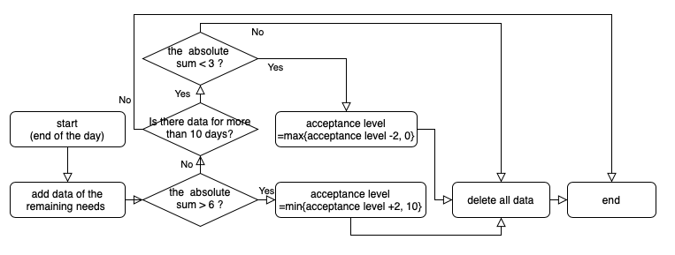
Acceptance Strategy 2/2 ~The Way of Updata Acceptance Level~
Update acceptance level at the end of each day as follows by referring to data of the remaining needs (the initial value is 0)
Notes:
The initial value of acceptance is 0. And, SuzukaAgent updata acceptance level at the end of each day by referring to data of the remaining needs as shown in figure. When it is difficult to fulfill needs, Acceptance level increase and SuzukaAgent compromise the unit price.

Slide 10
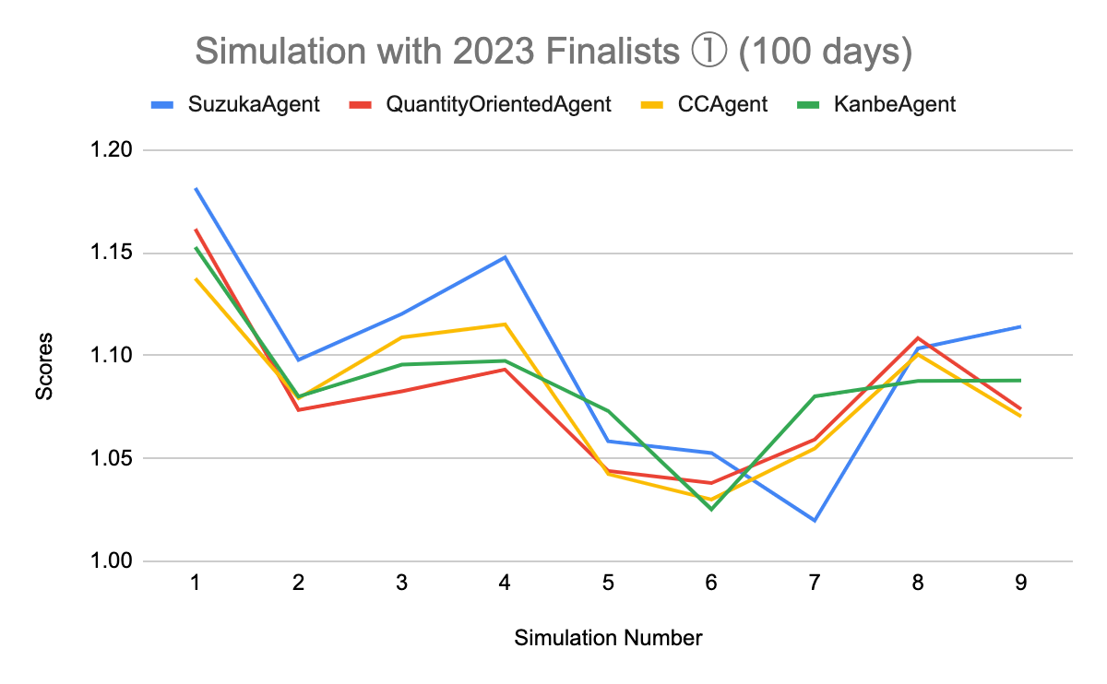
Evaluation 1/3
The simulation with the 2023 Finalists in 100 days
 | Mean | Median
SuzukaAgent | 1.09951 | 1.10348
KanbeAgent | 1.08666 | 1.08762
CCAgent | 1.08209 | 1.07931
QuantityOrientedAgent | 1.0816 | 1.07396
These were used in the reinforcement learning
Notes:
I’ll talk about the result of such a strategy.
I performed three simulations.
First Simulation is the simulation with the 2023 Finalists QuantityOrientedAgent, CCAgent, and KanbeAgent in 100 days. These were used in the reinforcement learning. SuzukaAgent is Blue line and get First Place on mean.

Slide 11
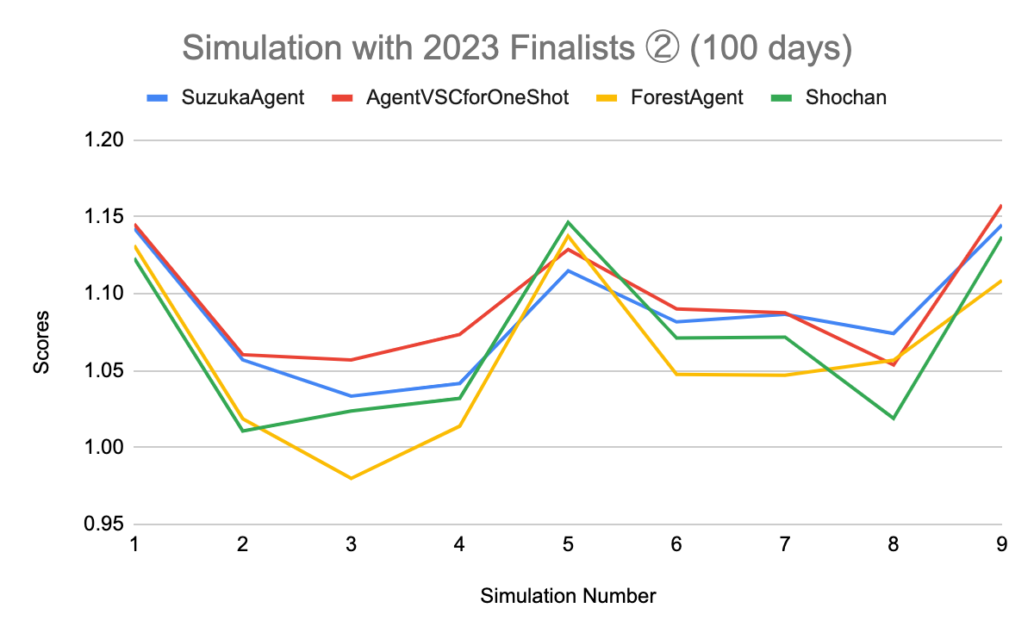
Evaluation 2/3
​​The simulation with the 2023 Finalists in 100 days
 | Mean | Median
AgentVSCforOneShot | 1.09480 | 1.08755
SuzukaAgent | 1.08631 | 1.0817
Shochan | 1.07055 | 1.07119
ForestAgent | 1.06015 | 1.04751
These weren't used in the reinforcement learning
Notes:
Second Simulation is the simulation with the 2023 Finalists AgentVSCforOneShot ForestAgent and Shochan in 100 days. These were not used in the reinforcement learning. SuzukaAgent is Blue line and get Second Place on mean.

Slide 12
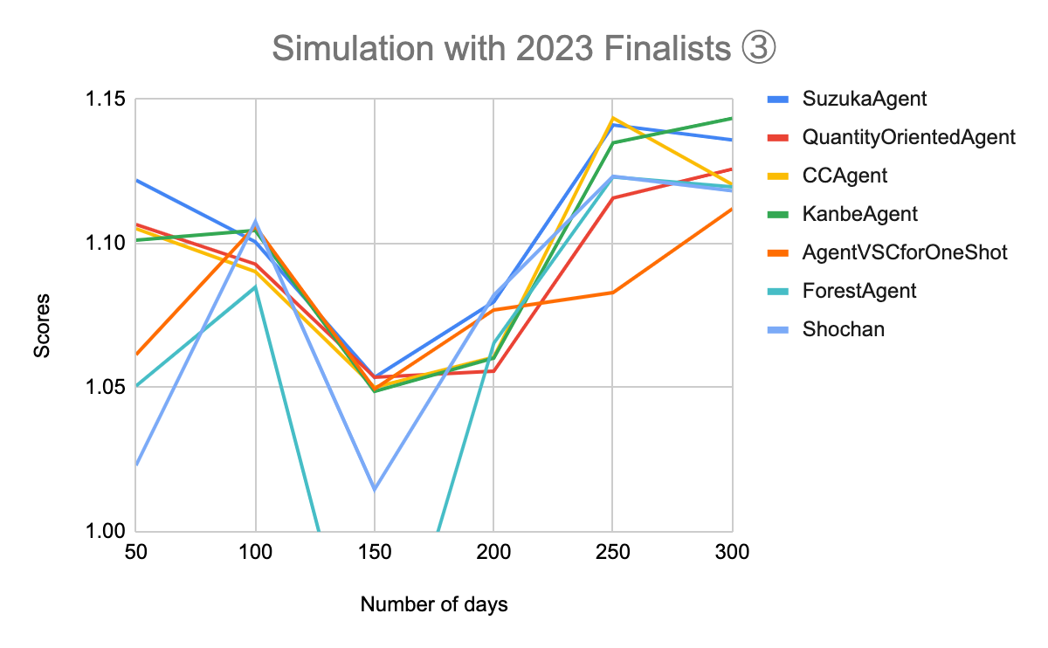
Evaluation 3/3
The result of the simulation with the 2023 Finalists in various days
 | Mean | Median
SuzukaAgent | 1.10550 | 1.11128
KanbeAgent | 1.09883 | 1.10286
CCAgent | 1.09501 | 1.09769
QuantityOrientedAgent | 1.09171 | 1.09970
AgentVSCforOneShot | 1.08149 | 1.07997
Shochan | 1.06156 | 1.09481
ForestAgent | 1.07816 | 1.07513
Notes:
Third Simulation is the simulation with the 2023 Finalists QuantityOrientedAgent, CCAgent, KanbeAgent, AgentVSCforOneShot ForestAgent and Shochan in various days. SuzukaAgent is Blue line and get First Place on mean.

Slide 13
Conclusion
SuzukaAgent adjusts the degree of priority for unit price flexibility in accordance with compatible with other factory agents
From the simulation results, it is evident that regardless of changes in factory agents or the number of days, high profits can be obtained by SuzukaAgent
Notes:
In Conclusion, SuzukaAgent adjusts the degree of priority for unit price flexibility in accordance with compatible with other factory agents.
And, From the simulation results, it is evident that regardless of changes in factory agents or the number of days, high profits can be obtained by SuzukaAgent

